Slide 1
CAWI in Latvian LFS
Labour Force Survey Workshop, Budapest, 16–17 May 2019
Inga Vanaga, Household Survey Design Section, CSB of Latvia

Slide 2

Data Collection Evolution in Latvian LFS
Period | Mode of interviews | Waves | Data entry programme
from November 1995 to 2005 | PAPI | All | Blaise
since 2006 | CAPI | All | Blaise
since Q2 2007 | CAPI CATI | All waves 2–4 | Blaise until Q1 2013 ISDAVS CASIS since Q2 2013
since 2018 | CAPI CATI CAWI | All waves 2–4 waves 2–3 | ISDAVS CASIS
Budapest, 16–17 May 2019
Labour Force Survey Workshop

Slide 3
Data Entry Programme for Latvian LFS
ISDAVS CASIS:
- Metadata-Driven Integrated Statistical Data Management System – Computer Assisted Survey Information System (MD ISDMS CASIS)
- Developed by iSoft Solutions (Latvian IT services company specializing in software development)
ISDAVS CASIS vs Blaise:
+ much cheaper
‒ not so flexible
Budapest, 16–17 May 2019
Labour Force Survey Workshop

Slide 4
Decision on using CAWI
Background for introducing CAWI in LFS:
- lower interviewing costs;
rising interest in possibility to use e-questionnaire;
- decision was made in 2016.
Pilot field work period:
Q2 2017
Principle of CAWI pilot:
- wave 5 of LFS with updated questionnaire
Budapest, 16–17 May 2019
Labour Force Survey Workshop

Slide 5
CAWI Pilot RUN-UP
Run-up period | January–April 2017
Selection of respondents | wave 4 included a question about willingness to participate in pilot test
Questionnaire updating | - reviewing wording of questions, answers, explanations (5 persons) - updating data entry programme (3 persons) - testing data entry programme (5 persons)
Budapest, 16–17 May 2019
Labour Force Survey Workshop

Slide 6
CAWI Pilot Field Work
Field work period | 17 May–4 June (19 days)
Invitation letter | on 12 May (5 days before starting CAWI)
Reminder | 26 May (on 10th day after starting CAWI), via e-mail
Connection to web questionnaire | - one person from household - via internet bank, e-identification card or e-signature.
Languages of questionnaire | Latvian, Russian
Budapest, 16–17 May 2019
Labour Force Survey Workshop

Slide 7
Results of CAWI Pilot
CAWI pilot participation:
- 107 households promised to participate
- 40 households participated actually (37.4%)
Respondents:
72% women
28% men
Average age of respondent ‒ 46 years.
Budapest, 16–17 May 2019
Labour Force Survey Workshop

Slide 8
Conclusions of CAWI Pilot
CAWI interviews are longer
CAWI pilot: 9 min. per person
CAPI/CATI: 6 min. per person
2. Web questionnaire was mostly accessed
on working days (88%)
3. Reminder is suitable
24% of respondents reacted to the reminder
4. Respondent e-mail addresses are the ones used in job.
Budapest, 16–17 May 2019
Labour Force Survey Workshop

Slide 9
Characterization of CAWI in Core Survey 2018
Waves of interviews and questionnaires | 2nd and 3rd waves (gradual introduction) Core questionnaire without structural indicators Core questionnaire + ad hoc module in Q2 Core questionnaire in Q1, Q2 and Q4 quarter
Accessing web questionnaire | One household member aged 15–64 Households which responded in previous wave and mentioned that have possibility to use internet Via internet bank, e-identification card or e-signature
Interviewing period | One week after reference week (7 days)
Changing mode | In case of CAWI non-response: 1 day is foreseen to change mode Household with phone number → to CATI Household without phone number → to CAPI
Budapest, 16–17 May 2019
Labour Force Survey Workshop

Slide 10
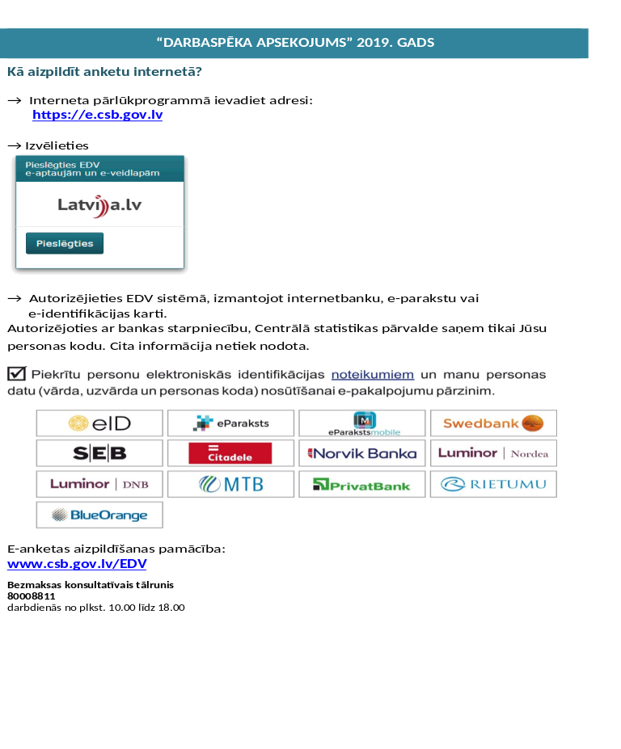
Instructions for Accessing LFS E-Survey
Budapest, 16–17 May 2019
Labour Force Survey Workshop

Slide 11
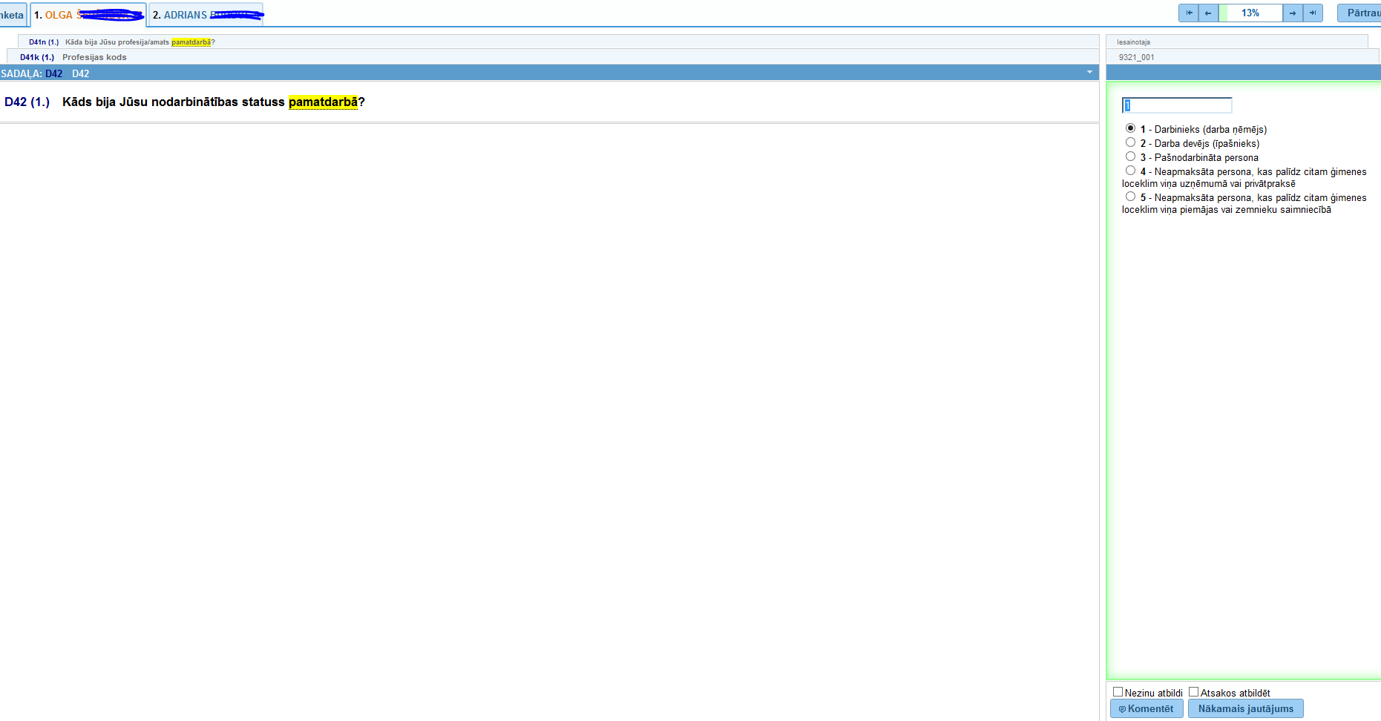
LFS Questionnaire Design in ISDAVS CASIS
Budapest, 16–17 May 2019
Labour Force Survey Workshop

Slide 12
Thoughts after First Year Using CAWI
Response rate is lower than expected
(responded 9% of households selected
for CAWI)
Management of field works becomes
complicated
3. One week for filling web questionnaire
is a little bit too short
Reminder via e-mail was not used widely
due to the lack of respondent e-mail
addresses
At present, CAWI takes small
share among interviewing LFS methods
Budapest, 16–17 May 2019
Labour Force Survey Workshop

Slide 13
Evolution of Mode Shares in Latvian LFS
Budapest, 16–17 May 2019
Labour Force Survey Workshop

Slide 14
CAWI in 2019
Period to complete e-questionnaire –
one week (as in 2018).
2. CAWI waves: Q2–Q4
3. Only core questionnaire
4. From Q3 contact persons aged 15+
Budapest, 16–17 May 2019
Labour Force Survey Workshop

