Slide 1
Income from main job in the Norwegian LFS
14th Workshop on Labour Force Survey Methodology, Budapest 16-17 May 2019
Ingvild Johansen, Statistics Norway

Slide 2
Background
LAMAS (2015): improve quality on income from main job
  Variable not included in the Norwegian LFS today
New data source for the register-based employment and wage statistics from 2015
Eurostat grants project (2017-2019)
  Aim: explore the possibility of using the new data source for measuring income in the LFS

Slide 3
New data source
New data source «A-ordningen» - a coordinated digital service
  Reporting on employees and income from employers to the Tax Administration, the Norwegian Labour and Welfare Organization and Statistics Norway
  Information is submitted electronically via the employer’s payroll system
  The deadline for reporting is the 5th of the following month
Provides more accurate and frequent information and a broader coverage of employees from all registered firms

Slide 4
Data integration
Some clear advantages for using register information
  More accurate information about the exact amount in gross terms, more cost efficient
  However, the quality of the end result depends on the coherence between the sources
The integrated data set is produced by combining the sample of employees from LFS with wages from the register at micro level
Target population: employed persons aged 15 to 74 years
Target concept: income from the main job

Slide 5
Definition of Incgross
Broader coverage compared to the wage statistics
  “Gross pay refers to the monetary component of the remuneration of employees in cash payable by an employer to an employee before deduction of income tax and National Insurance Contributions. It includes regular overtime, extra compensation for shift work, seniority bonuses, regular travel allowances and per diem allowances, tips and commission, compensation for meals”
Same definition as wage statistics, including overtime and holiday pay
  Cover most of the total amount
  Easily accessible - not all data are processed through the production system each month
  Good quality - the wage components are checked every month

Slide 6
Definition of Incgross II
Payments based on a period longer than a month, should according to the Eurostat guidelines, be proportionally included
Holiday- and bonus payments are usually received once a year
One-twelfth of the payments over the last 12 months will be included in the monthly pay as a proxy

Slide 7
Statistical unit
LFS: employed persons in main job
Register: jobs, i.e. a person working in a given establishment
  A person working part time in two different schools within the same municipality, will appear as two jobs in the register, but may be reported as one job in the LFS
Transformation of the object to unit has been explored
  Jobs belonging to same enterprise and with same occupational code are aggregated
  Larger impact on average wages for women than men
  Alternative: adjust wages with working hours in the LFS

Slide 8
Linking procedure
Focus on the quality at micro level
Primary key: personal identification number
  95 percent of the employed persons in the LFS are classified as employees in the register
Identifying the main job - a potential error
Tested two alternative procedures – similar result
  Using the register definition
  Using auxiliary information from the interview

Slide 9
Time period
Incgross should contain payments received in the calendar month either preceding or containing the reference week
  Using the calendar month containing the reference week gives better consistency between the two sources
  It also increases the probability for capturing new jobs

Slide 10
Imputation of earnings
Around 10 percent either missing or extreme values
  Persons registered as unemployed or outside the labour force in the register
  Employees temporarily absent from work
Variation in required imputation rates among groups
  Youngest and oldest age-groups are overrepresented, including those absent from work, with shorter contractual hours, or lower/missing education
  Significant differences in average wage – need to impute
Nearest neighbour imputation

Slide 11
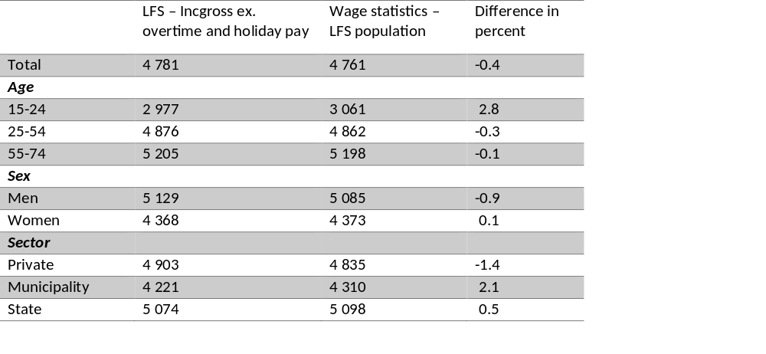
Comparison with wage statistics

Slide 12
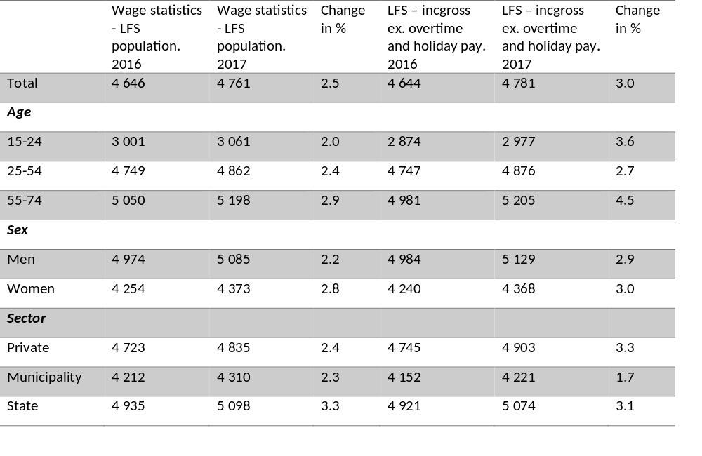

Slide 13
Summary
Some clear advantages for using register information
Figures at macro level not necessarily consistent with the wage statistics
  Important to interpret the results cautiously
  The aim is to provide a valuable supplement to the LFS dataset, allowing for new analysis (not to provide an additional measure of the wage levels in Norway)

Slide 14
Thank you!

