Slide 1
Incentives strategy at the ONS – a review
Lina Lloyd
ONS Social Survey Operations
lina.lloyd@ons.gov.uk

Slide 2
Current situation

Slide 3
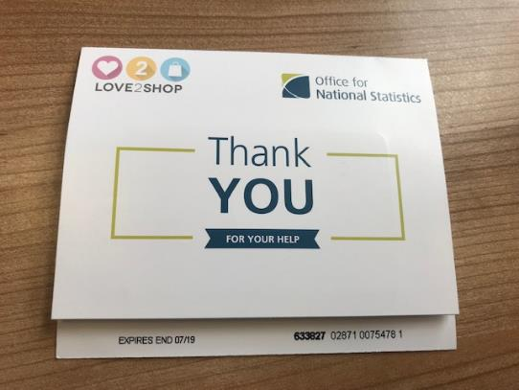
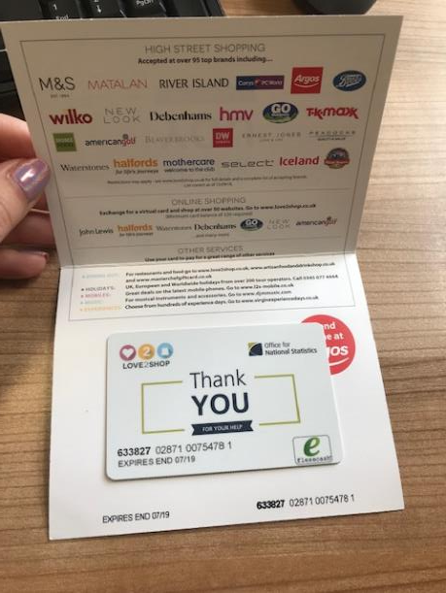
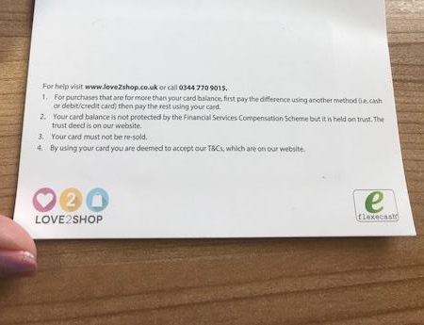
History of incentives for the LFS
Current
LFS
First class postage stamps in August and December months only
Unconditional mixed monetary incentive trial (£5 vs. £10) in 2017-2018
Costly and cannot offer all respondents a £10 gift card
Switched to a gift card with a 6 month expiry from July 2018

Slide 4
The five proposals

Slide 5


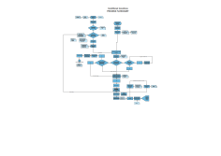
1. Increasing role of conditional incentives
More information…
In research unconditional incentives are often found to be more effective than conditional
Conditional incentives are more cost effective ⇨ can therefore potentially increase monetary value
Reducing delay from 6 to 8 weeks to 1 or less by having interviewers issue the incentives would likely result in no or minimal percentage point reduction in response rate
An operational test as part of the LFS Dress rehearsal will be carried in in September/October this year
Evidence for this…
NatCen uses this approach as BAU.
Less difference in response rates between conditional and unconditional incentives when survey mode is interviewer mediated
Literature suggests that the delay of receiving the conditional incentive could be a key factor influencing its effectiveness on response rates
Interviewers fed back that they would prefer to issue incentives themselves
Reduced impact on the field management team

Slide 6
2. Introduce discretionary incentives
More information…
Discretionary incentives are used to convince reluctant respondents to take part. This is done by offering an additional or higher incentive amount
  Tool to boost response when needed the most
Hidden discretionary incentives module in the questionnaire to be activated on an ad-hoc basis
Can only be done after conditional incentives issuing is changed
Evidence for this…
Offering non-respondents an incentive that was slightly higher than the initial incentive was effective in converting non-respondents to take part in a survey request
NatCen has found that offering discretionary incentives works on other government commissioned surveys
Fairly small impact on sample bias, and could reduce differences seen in survey take-up by younger respondents

Slide 7




3. Low-value unconditional incentives for web surveys
More information…
Incentive is needed due to low-uptake for completion associated with online mode
Low value incentives are effective at boosting online response:
  Non-monetary: tote bag
  Monetary: £5 gift cards and free prize draws
Incorporate recommendations from the Incentives Strategy Review in ongoing transformation tests
  Explore packaging and dispatching resources if tote bags were to be used for large scale roll out
  Explore other incentives for online modes, free prize draw incentives, pop-up leaflet, low monetary Love2Shop vouchers, other
Evidence for this…
Online surveys usually have an increased sample size to mitigate the lower survey response so it’s too costly to offer higher value incentives
Online LFS trial exploring both unconditional non-monetary (tote bag) and lower monetary incentives (£5, or £5 followed by conditional £10)
Statistics Netherland successfully trialing lottery draws for the online LFS
Cost analysis showing cost savings when offering non-monetary incentives for online modes

Slide 8
4. Explore loyalty points based incentives
More information…
Seen as an incentive and in-between wave engagement
The loyalty points achieved should increase in value with continued cooperation in longitudinal surveys
  Encashing a higher incentive at the final wave should be more motivating for the respondent than receiving smaller incentives after a given wave
  Loyalty points should be offered in addition to unconditional incentives at wave 1 in the web mode
  This needs to be explored in the LFS transformation tests
Evidence for this…
Behavioural science theories support this
incentive strategy:
  loss aversion
  endowed progress
  goal gradient effect
Research showed that loyalty points elicited a significantly higher response rate in comparison to offering monetary incentives
  Loyalty points incentive also resulted in less attrition
  The effectiveness of the loyalty points increased as more waves went on
Notes:
Loss aversion – states that people would rather not lose £5 than gain £5, so respondents would rather not lose the points they have gained so far
Endowed progress states that people are more likely to do something if they’ve already started a process
Goal gradient effect - states that the closer people are to a goal, the more effort they put in to reach it.

Slide 9
5. Investigate offering a choice of conditional incentives
More information…
Research has seen that different incentives elicit different response behaviour across population groups
  Younger respondents
  Ethnic minority groups
Alternative strategy to targeted incentives.
  All respondents treated the same
  Helps to overcome the ethical constraints of targeted incentive approaches
  No prior knowledge about the respondents’ characteristics is required
Evidence for this…
Not clear whether it is due to the choice in itself or the choices that are being presented that offering a choice increases engagement
‘Personal touch’ to cooperation requests seem to be the key in increasing engagement
However, it is clear that the choice of incentive:
  Increase reciprocity
  Increase respondent engagement
  Make survey request personal

Slide 10
Timeline

Slide 11
Current
Unconditional incentives
-Multi-shop gift card
-£5
-£10
Next 12 months
1. Increasing role of conditional incentives for personal interviews
2. Discretionary incentives
3. Low value incentives trialed on surveys that are moving online to have alternative solutions to the tote bags
Longer term
1. One agreed unconditional incentive for online surveys
2. Conditional incentive option for web non-responders that are followed up
3. Explore loyalty points based incentives to retain survey panel
4. Investigate offering a choice of conditional incentives

Slide 12
Questions?
Email lina.lloyd@ons.gov.uk

Slide 13
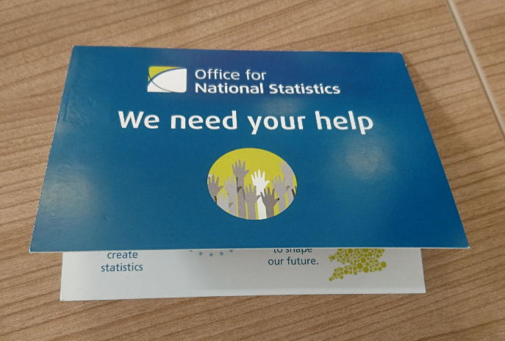
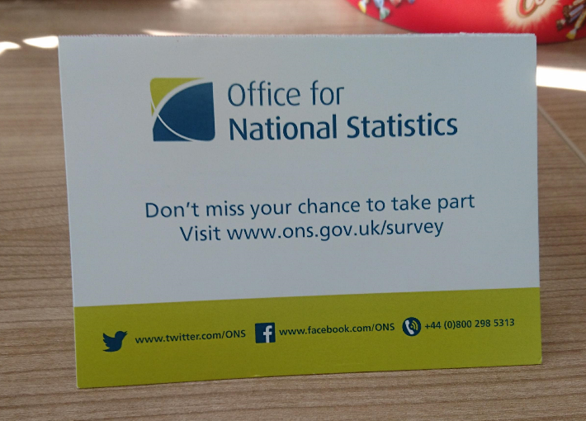
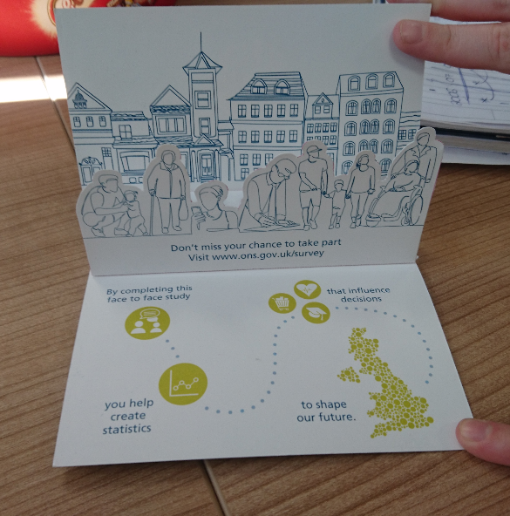

Slide 14




Slide 15
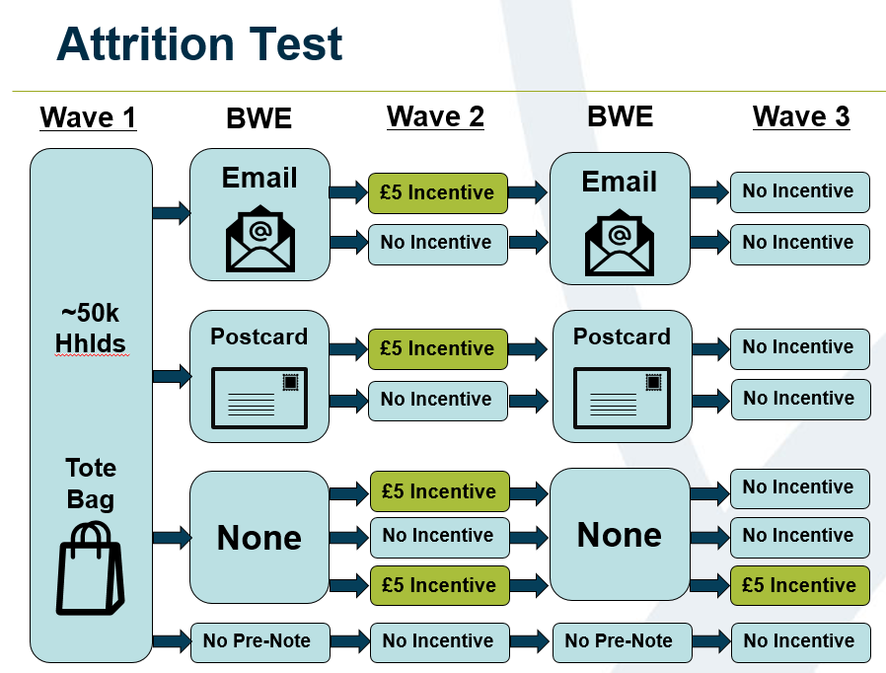
SST LMS attrition test design

